Slide 1
Lab # 2 (Week # 4)
Thread schedules and Thread ID in #pragma omp parallel
#pragma omp critical
Use of variable in a OpenMP program
#pragma omp parallel for
Nowait clause

Slide 2
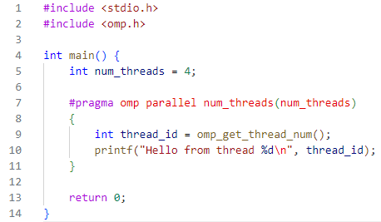
Using omp_get_thread_num()
The order of thread execution may vary depending on your system's scheduling.

Slide 3
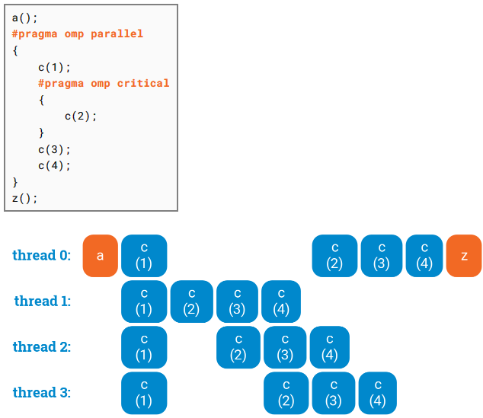


Slide 4
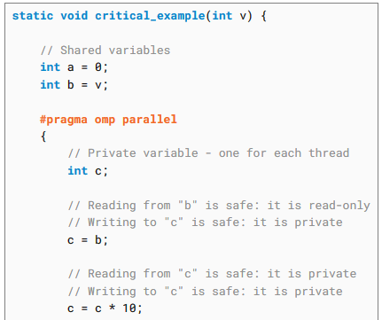
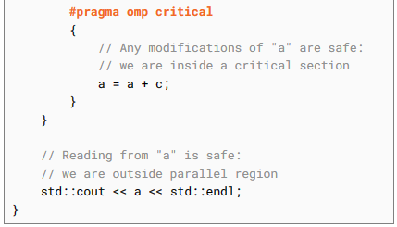

Slide 5
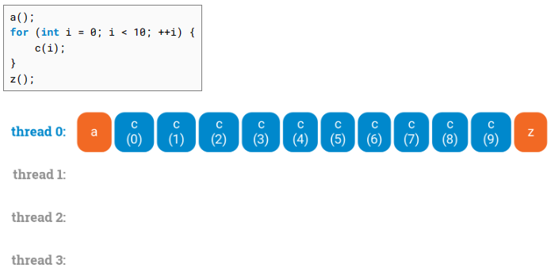
for-loop in C code uses only one thread

Slide 6
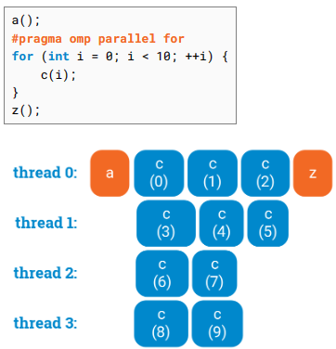
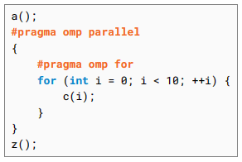
Don’t use this
Use This ✓

Slide 7
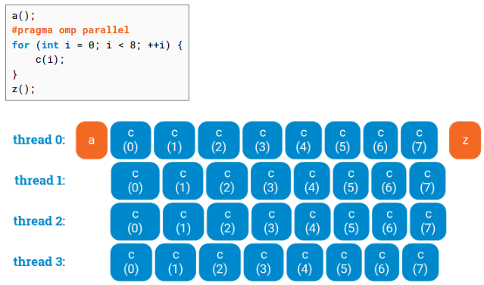
ERROR

Slide 8
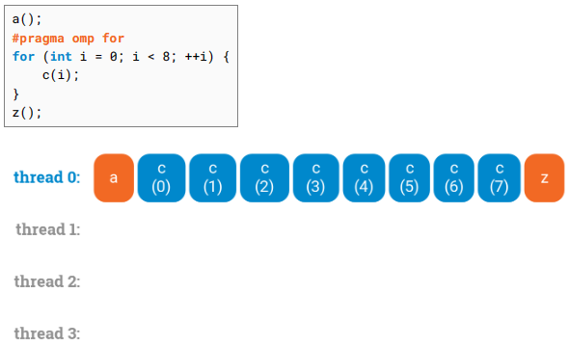
ERROR

Slide 9
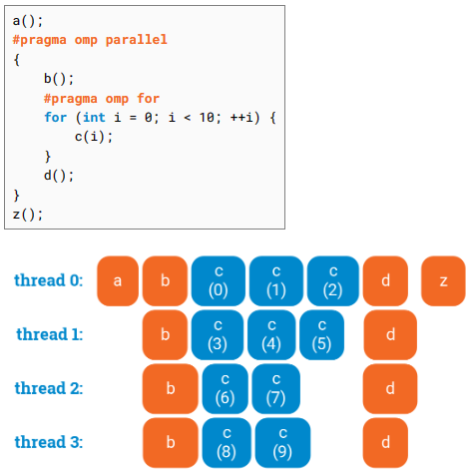
#pragma omp parallel for
cannot be used alone in this case.
Why?

Slide 10
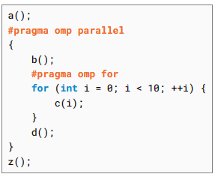
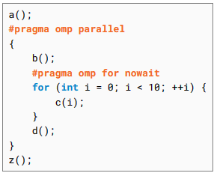
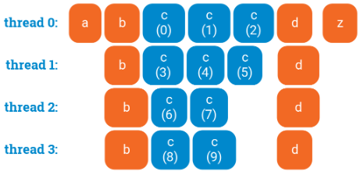
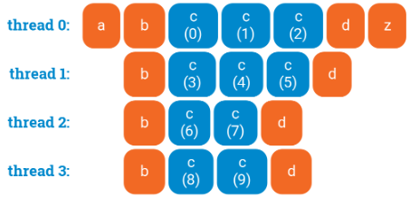
Example # 1

Slide 11
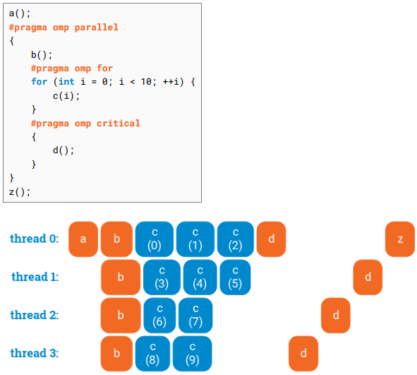
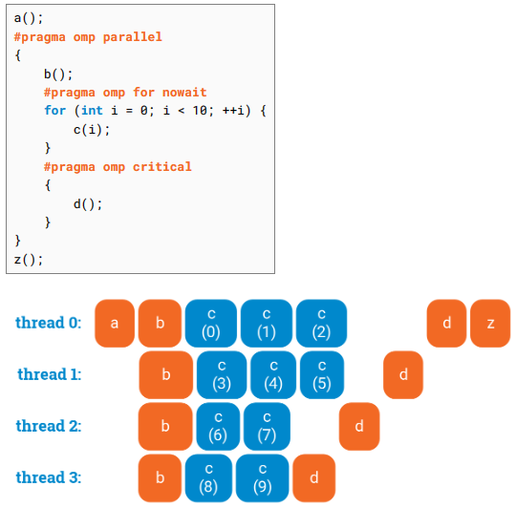
Example # 2

Slide 12
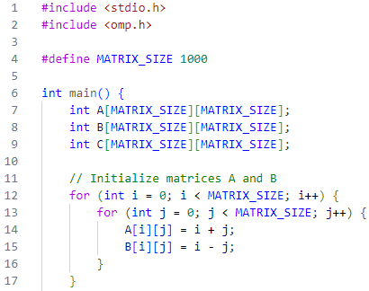

Slide 13
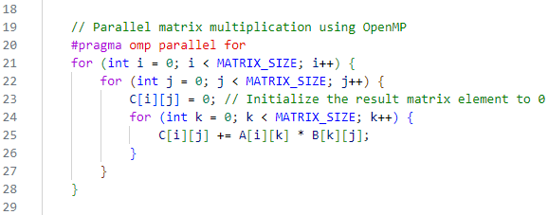

Slide 14
